Slide 1
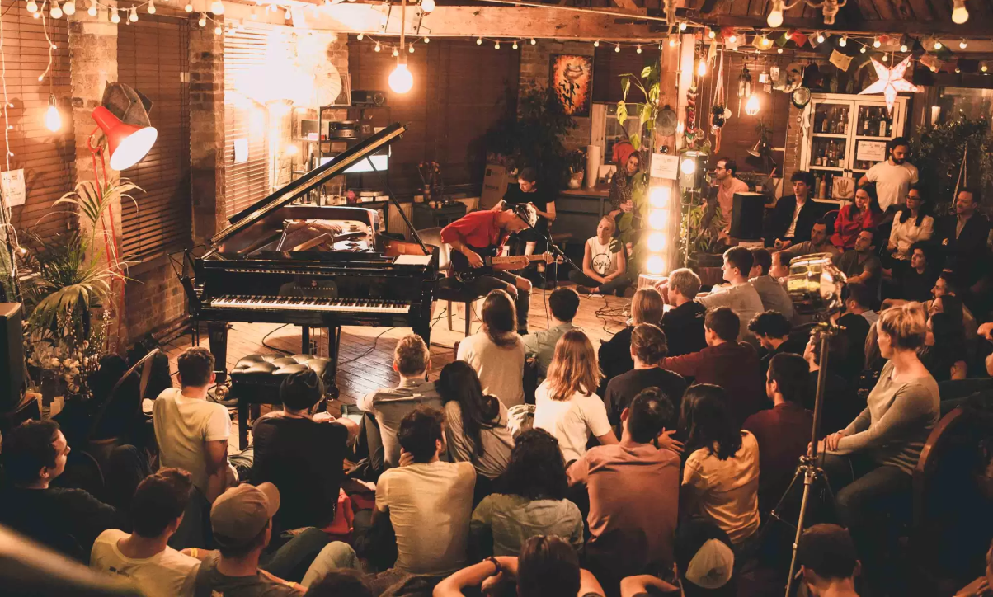
Impact of Live Music in New York Bars
3rd December 2019
https://www.cntraveller.com/gallery/live-music-bars-london/
Notes:
Hi there, I am Robin Jindal from team 6. Today, we will be discussing the impact of live music in bars in New York City.

Slide 2









Team and Agenda
AGENDA
Business Problem
Motivation
Jeffrey Chittaranjan
Siddharth Harisankar
Approach & Analysis
Business Actions
Limitations
Robin Jindal
Xuanming Hu
Team6, Team Profile:
12+ years of cumulative experience in analytics and consulting with key clients across diverse industries
Notes:
We are a team of analytical consultants and really passionate about this project. This is our plan for today and let’s get started.

Slide 3




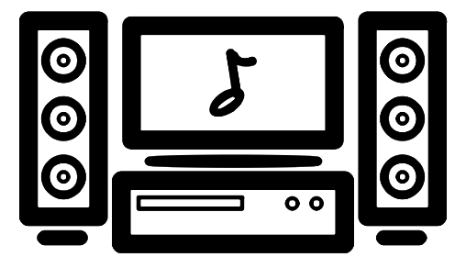
Business Problem
Bar owner in New York
Introduce live music
Stick with:
Jukebox
DJ
Karaoke
Business questions to answer :
Would live music improve average rating?
Would live music attract more people?
Would live music create positive sentiments on online sites?
Would live music be cost effective?
Business Problem | Motivation | Approach & Analyses | Business Actions | Limitations
Notes:
Our client is a bar owner in new York city. Since new York is a home to 10s of 1000s of bars, our client wants to attract people to his bar. He wants to analyze public sentiments on online platforms and want to decide whether he should make some investment in order to attract more crowd. One such investment he is looking for is live music. Invest in live music at his bar or stick with the already installed music in the form of Jukebox, DJ or Karaoke. Before deploying any changes our client would like to know if employing live music:
Improve average rating
Would it be able to increase the footfall of consumers?
Would it spread positive sentiments ot online platforms?
And more from an investment point of view, would it be cost effective

Slide 4
Live music promotes better dining experience
Motivation for the Project
BUT
Artist Cost
comes with significant costs
Licensing Cost
Significant space occupied
94 %
45 %
People look online to decide which bar to go
People look YELP to decide bar to go
So, by monitoring Yelp reviews we can gauge clientele of a bar.
Business Problem | Motivation | Approach & Analyses | Business Actions | Limitations
/
https://smallbiztrends.com/2018/06/how-diners-choose-restaurants.html/
https://www.reviewtrackers.com/blog/yelp-factsheet/
https://www.barbusinessowner.com/public/Music-Licensing-for-Bars-and-Restaurants.cfm
http://crazyalanswampshack.com/blog/why-live-music-promotes-a-better-restaurant-dining-experience-for-everyone
Notes:
From external research we came to know that Live music promotes better dining experience and hence improve overall consumer experience. But playing live music comes with significant costs namely Paying the artist, getting the license to play live music and a loss of opportunity cost in terms of the space it requires.
By delving deeper into external research we understood that 94% of people look online to decide which bar to go. 45% of these look at Yelp reviews. So we believe by monitoring Yelp reviews we will be able to correctly gauge how our investment would affect our Performance.

Slide 5
Analysis Performed
Regression analysis between:
Bar Performance & Presence of live music
1. Scrape Yelp Reviews
Random Selection:
50 Live music Bars + 50 with no Live music
2. Sentiment Analysis on Reviews
35k Reviews
3. Linear Regression
1 Business Idea
Business Problem | Motivation | Approach & Analyses | Business Actions | Limitations
https://smallbiztrends.com/2018/06/how-diners-choose-restaurants.html/
https://www.reviewtrackers.com/blog/yelp-factsheet/

Slide 6


Analysis Performed contd.
1. Why scrape Yelp reviews?
Reliable source for extracting restaurant reviews with 2.6M diners seated via Yelp
2. Why sentiment analysis on reviews?
Obtain polarity (positive or negative opinion) of reviews across bars with and without live music
3. Why perform linear regression?
Identify & quantify the relationship between live music and bar performance on online platforms
Business Problem | Motivation | Approach & Analyses | Business Actions | Limitations

Slide 7
Data
1360 bars
Bars with any kind of music on Yelp
841 bars
52 bars
Live Music
Karaoke
310 bars
279 bars
DJ
Jukebox
60%
Bars have
Live Music
Some bars have multiple tagging
So, we took a sample of 100 bars with
50 Live music bar + 50 Non Live Music Bar
Business Problem | Motivation | Approach & Analyses | Business Actions | Limitations

Slide 8

Hypotheses
Live
Music
Restaurant
Rating
Research Study: Live music augments the overall consumer experience at a bar
and as a result:
Restaurant
Rating
Customer
Revenue
attracts
drives
Business Problem | Motivation | Approach & Analyses | Business Actions | Limitations
http://crazyalanswampshack.com/blog/why-live-music-promotes-a-better-restaurant-dining-experience-for-everyone/

Slide 9
Business Interpretations - I
Business Query: Does presence of live music has impact on average rating?
Equation 1:
$$Average Rating=3.61361+0.20552∗(Dummy Live)$$
1 : If the Bar has Live music
Dummy Live
0 : If the Bar doesn’t have Live music
95%
Confident about significance of Dummy Live
Live Music Bars tend to have higher average rating compared to Bars with no live music
Business Problem | Motivation | Approach & Analyses | Business Actions | Limitations

Slide 10
Business Interpretations - II
Business Query: Does presence of live music has impact on consumer sentiment?
Equation 2:
$$Average Sentiment Score=0.224711+0.048535∗(Dummy Live)$$
1 : If the Bar has Live music
Dummy Live
0 : If the Bar doesn’t have Live music
95%
Confident about significance of Dummy Live
Live Music Bars tend to have higher average
sentiments compared to bars with no live music
Business Problem | Motivation | Approach & Analyses | Business Actions | Limitations
http://crazyalanswampshack.com/blog/why-live-music-promotes-a-better-restaurant-dining-experience-for-everyone/

Slide 11
Business Interpretations - III
Business Query: Does presence of live music has impact on number of Reviews?
Equation 3:
$$Number of Reviews=217.50+271.34∗(Dummy Live)$$
1 : If the Bar has Live music
Dummy Live
0 : If the Bar doesn’t have Live music
95%
Confident about significance of Dummy Live
Live Music Bars tend to have higher number of
reviews compared to Bars with no live music
Business Problem | Motivation | Approach & Analyses | Business Actions | Limitations
http://crazyalanswampshack.com/blog/why-live-music-promotes-a-better-restaurant-dining-experience-for-everyone/

Slide 12
Business Interpretations - IV
1,000
customer visits
1
Review on Yelp
Assumption 1:
$
$10
Assumption 2:
Average Customer
Spending
$$
$20
Mathematical
Representation
$$Revenue=\left(\# Reviews\right)∗\left(1,000\right) ∗(Avg Consumer Spending)$$
160% more*
Revenue in Live Music bars
compared to Non Live music bar
Business
Impact
* Based on T-test
Business Problem | Motivation | Approach & Analyses | Business Actions | Limitations

Slide 13



Recommended Business Actions
Karaoke
DJ
Jukebox
Live music
Impact of Business Actions
More reviews *
Better sentiment
Higher ratings
Higher revenue
* Number of Reviews: Proxy for footfall
Business Problem | Motivation | Approach & Analyses | Business Actions | Limitations
http://crazyalanswampshack.com/blog/why-live-music-promotes-a-better-restaurant-dining-experience-for-everyone/

Slide 14
Further Study - Cost Analysis
Profit Live Music
Revenue Live Music
Cost Live Music
# of Customers
Revenue per Customer
Fixed Cost
Variable Cost
Opportunity Cost
Average Rating
Setup Cost
Artist Cost
Space Utilization
# of Reviews
$500
per year
$50 - $100
per hour
Can be profitable if the revenue from investing is greater than cost to set it up.
Business Problem | Motivation | Approach & Analyses | Business Actions | Limitations
https://www.thumbtack.com/p/musician-cost
/

Slide 15
Limitations
Limited Number of Bars: Scraping is time consuming.
Equal weightage to each review : More weightage could have been given to
most useful reviews.
Assumption: Enough Budget and Space in bar to deploy Live music
Business Problem | Motivation | Approach & Analyses | Business Actions | Limitations
http://crazyalanswampshack.com/blog/why-live-music-promotes-a-better-restaurant-dining-experience-for-everyone/
Notes:
Scraping all bars could make the data imbalanced and give a biased estimate of average rating and average sentiment score of live music and other music

Slide 16
Future Scope
Generalized Suitable Music Prediction Model
Restaurant
Collect data & Predict for all types of restaurant and not just bars.
Neighborhood
Gives recommendation based on the nearby restaurants
City
A general model for all cities in United States and not just New York City
Music Model that not only tells about live music but recommends the suitable music type
Business Problem | Motivation | Approach & Analyses | Business Actions | Limitations

Slide 17
Additional Datasets Required for future Study
Sales Data
We would require the sales data for each and every review.
Sales data before and after installing any kind of music
Reviews
Real-time reviews of each and every restaurant.
Reviews before and after deploying the music
Both of these inputs would allow A/B testing.
Business Problem | Motivation | Approach & Analyses | Business Actions | Limitations

Slide 18
Thank You

Slide 19
Appendix

Slide 20
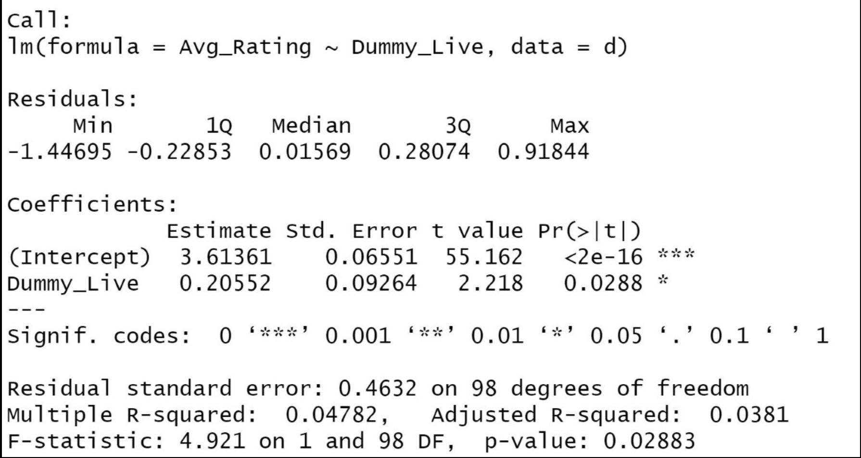
Regression Equation - 1

Slide 21
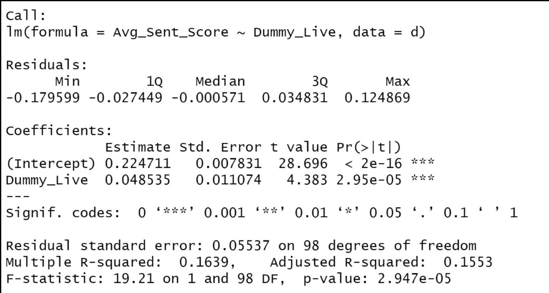
Regression Equation - 2

Slide 22
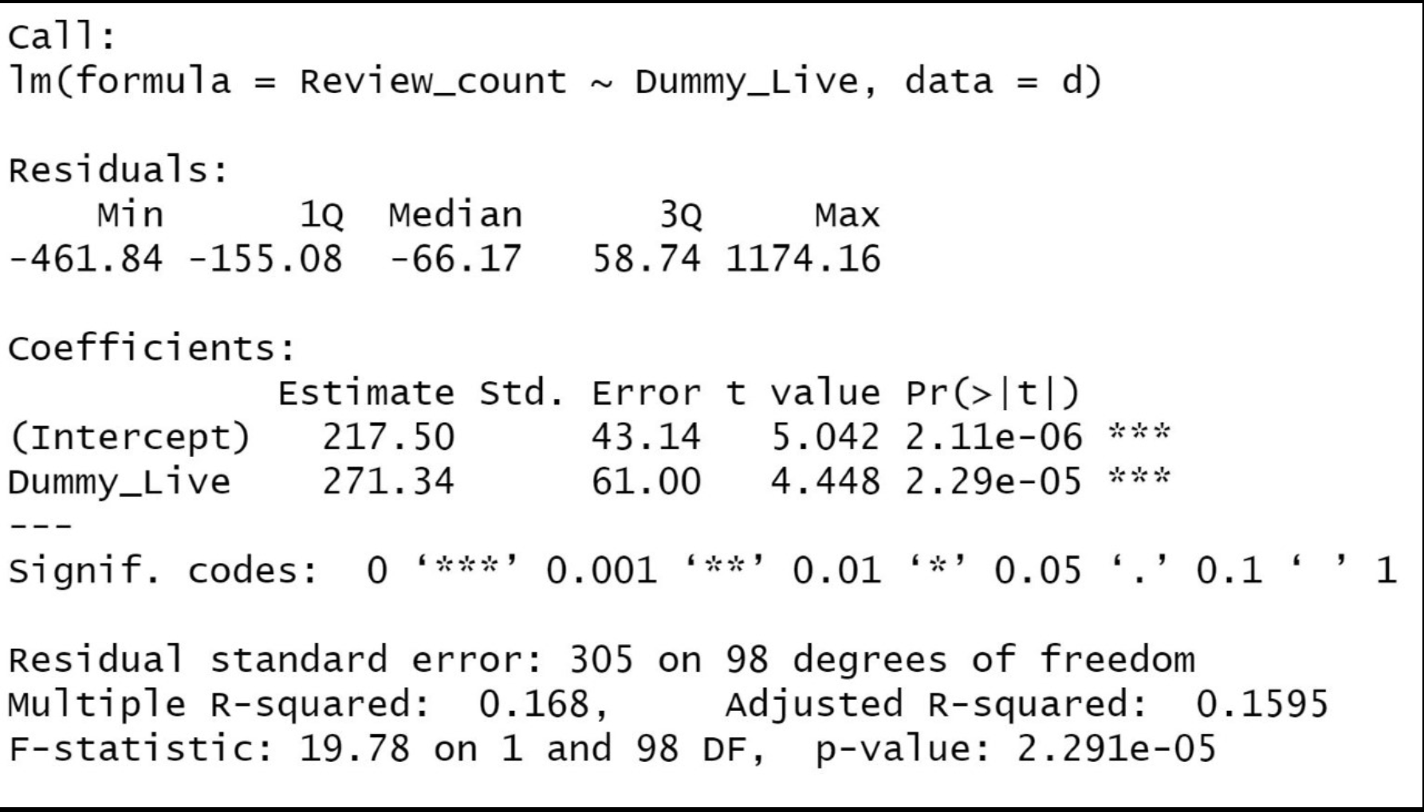
Regression Equation - 3

Slide 23
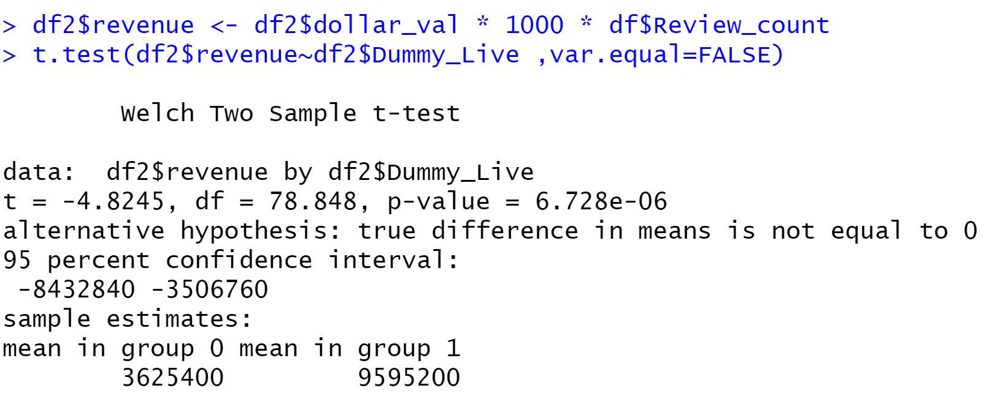
T-test for difference in revenue at Live music bars and Non Live music bars

Slide 24
City has an active nightlife Large number of bars, Hence huge data points Variations in bars is also high
Why New York?

Slide 25
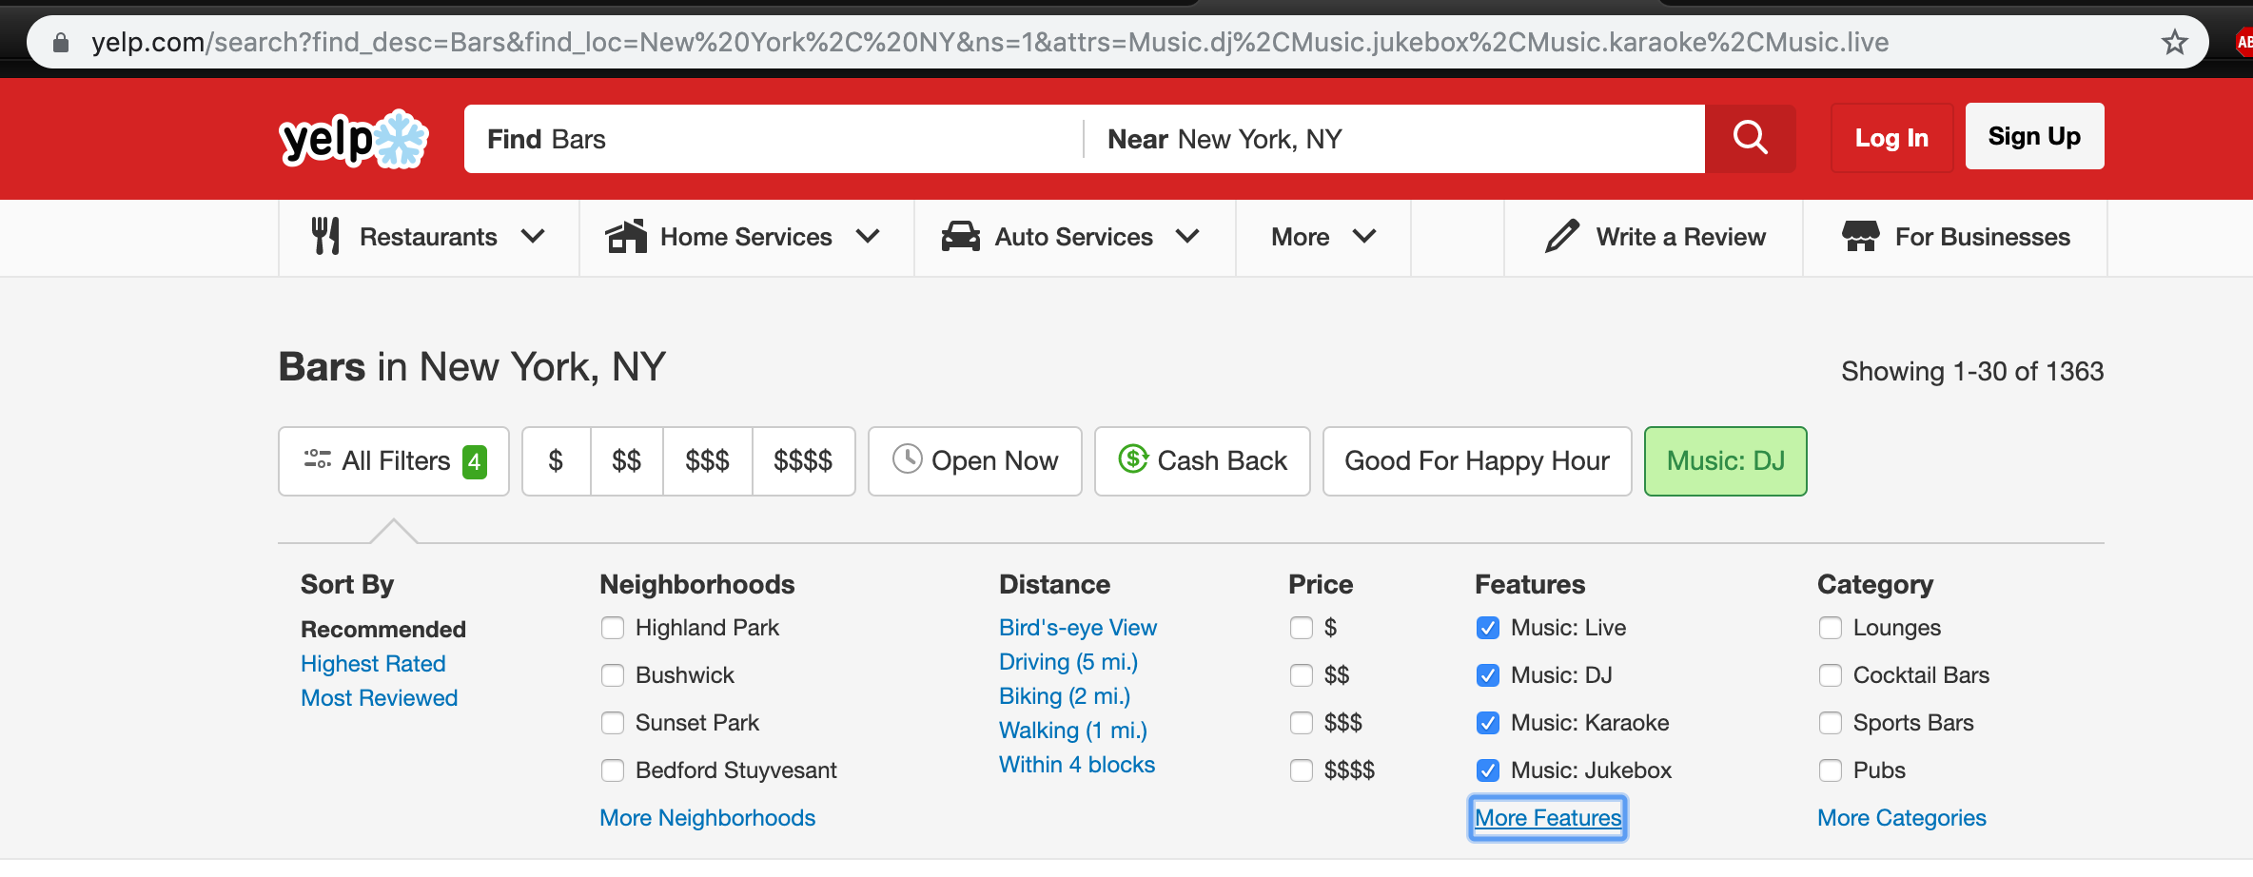
Getting Data from Yelp

Slide 26
https://www.sciencedaily.com/releases/2016/07/160728125306.htm - This link said that music makes beer taste better. → Happy Customers https://www.sciencedaily.com/releases/2008/07/080718180723.htm - This link said that music makes you drink more in less time in a bar → More Sales. Happy You!!! https://restaurant.org/Articles/Operations/How-music-establishes-mood-and-drives-restaurant-p - examples are sports bars, where music from TVs highlighting action in the game provides a fitting soundtrack to the hustle and bustle of a lively crowd. At the other extreme are steakhouses and fine dining establishments. Here, the desired sonic mood is one that establishes a sense of calm and relaxation, one befitting a larger proportion of mature patrons.
Influence of Music on Sales

